Slide 1
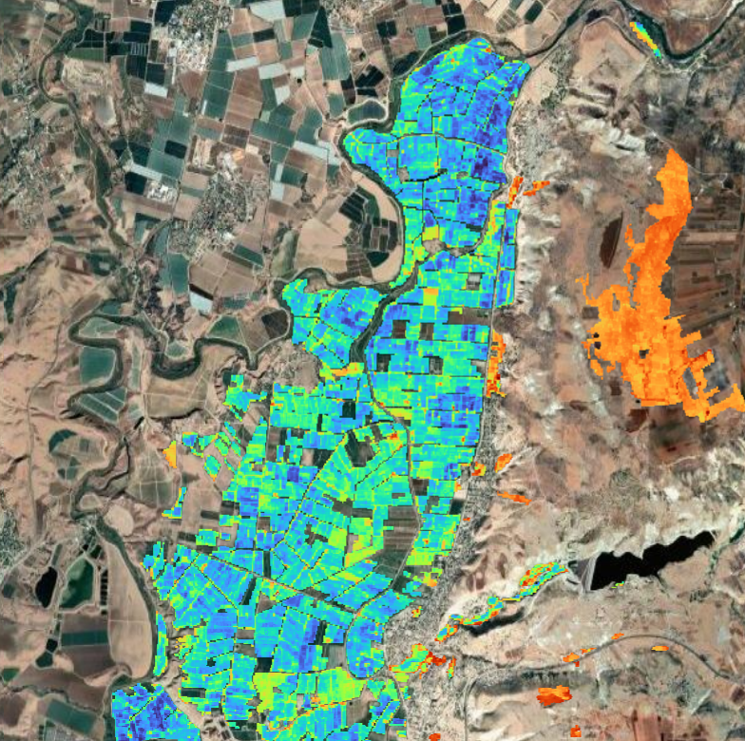

Water Consumption and Crop Evapotranspiration Analysis of Citrus in NJV Using WaPOR Data
Almutaz Mohammed
Land & Water Division (NSL), FAO
Prof. Jawad Al-bakri
University of Jordan

Slide 2
Contents
Study Area: Citrus Farms in NJV
WaPOR Datasets Used
Precipitation (PCP)
Reference Evapotranspiration (RET)
Actual Evapotranspiration (AETI)
Seasonal and Monthly Analysis (2018–2024)
Crop Evapotranspiration (ETc) Calculations
FAO Kc method
Variations by canopy and tree height
Adequacy of Water Consumption
Conclusion

Slide 3
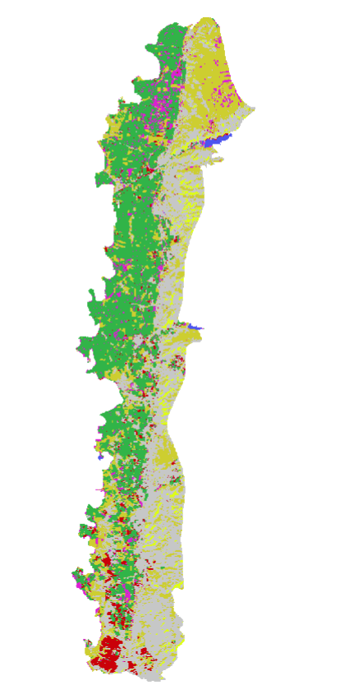
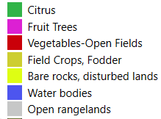
Introduction
 | Area (1000 du) | % of NJV
Citrus | 58.9 | 32.4
Fruit Trees | 9.4 | 5.2
Vegetables-Open Fields | 7.3 | 4.0
Field Crops, Fodder | 40.8 | 22.4
Bare rocks, disturbed lands | 5.1 | 2.8
Water bodies | 0.7 | 0.4
Open rangelands | 59.9 | 32.9

Slide 4
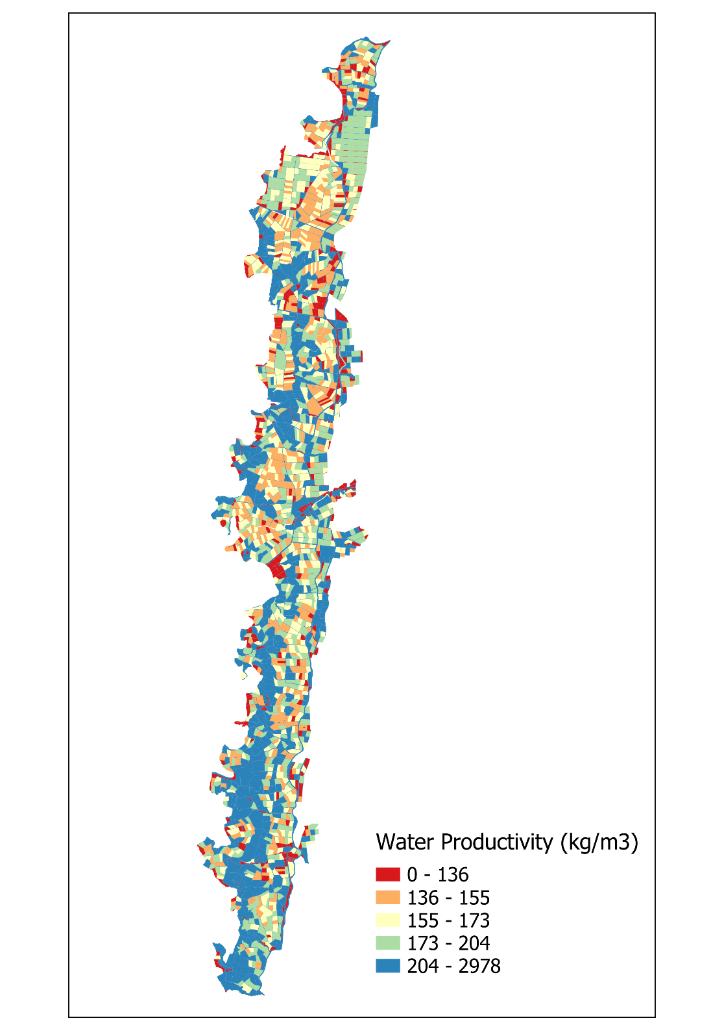
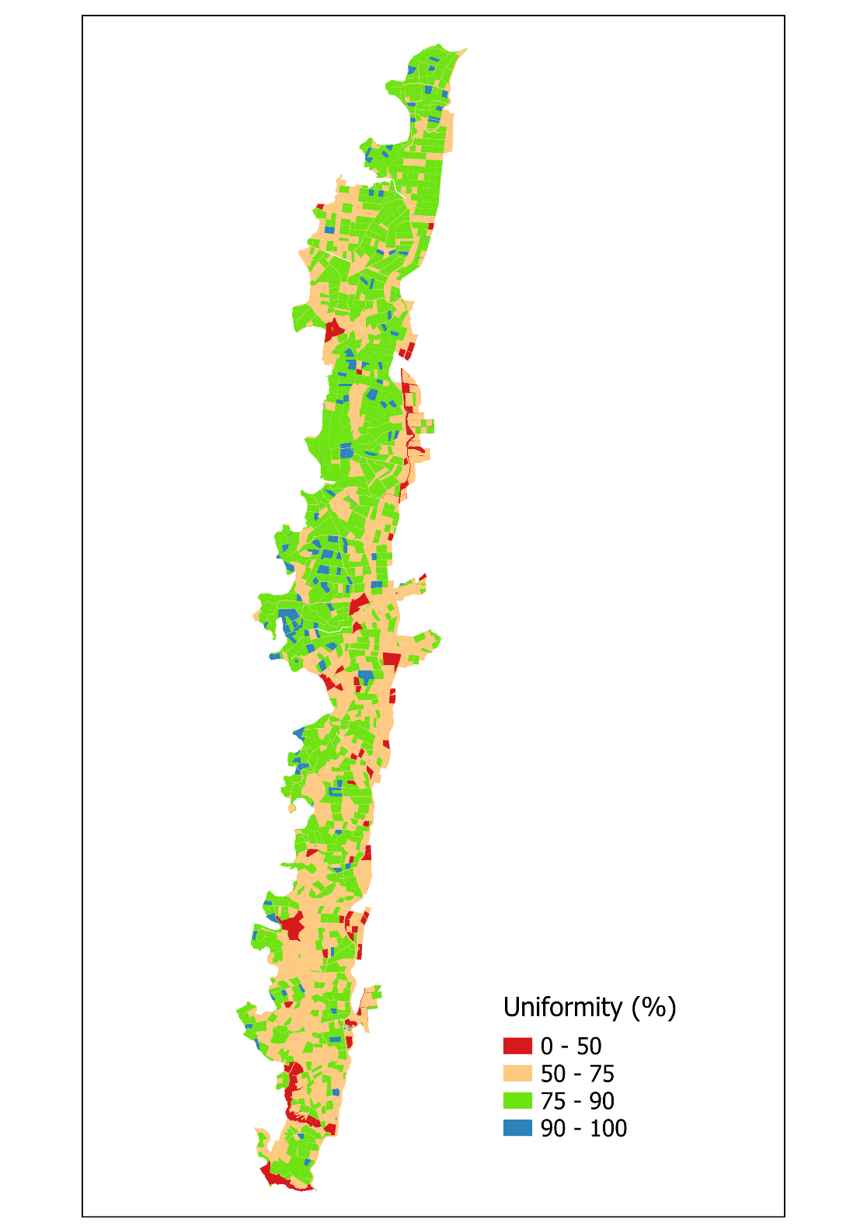

Slide 5



Introduction
Citrus is one of the dominant cash crops in the region of North Jordan Valley (NJV), covering on average ~6,600 hectares (crop map 2019), and is central to local livelihoods and agricultural water use.
Why Remote Sensing (WaPOR)?
Provides spatially consistent data on precipitation, evapotranspiration, and crop water consumption.
Allows multi-year and seasonal monitoring of citrus farms in NJV.
Identifies patterns and gaps in irrigation performance that can be validated through field data.
Role of Farm Surveys:
Capture ground-level factors (management practices, irrigation methods, crop conditions).
Provide context to interpret WaPOR-derived indicators.
Strengthen the linkage between observed water consumption and on-farm realities.
WaPOR

Slide 6
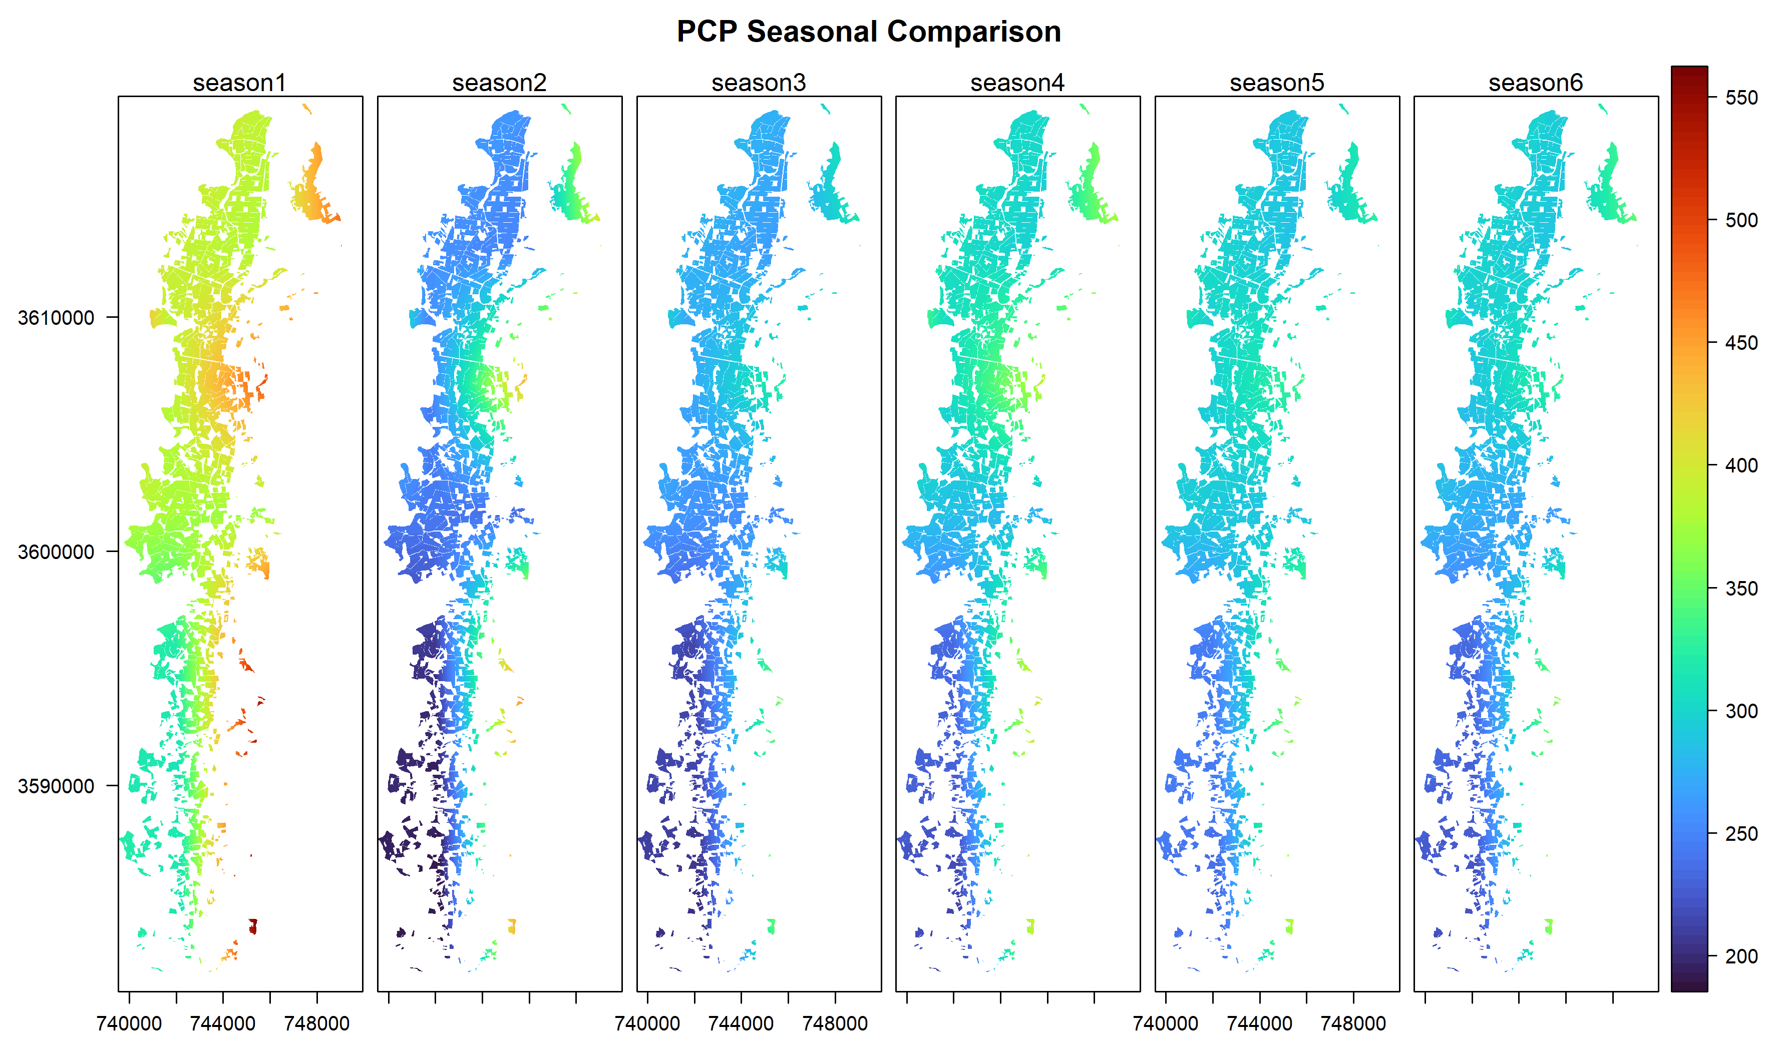

Slide 7
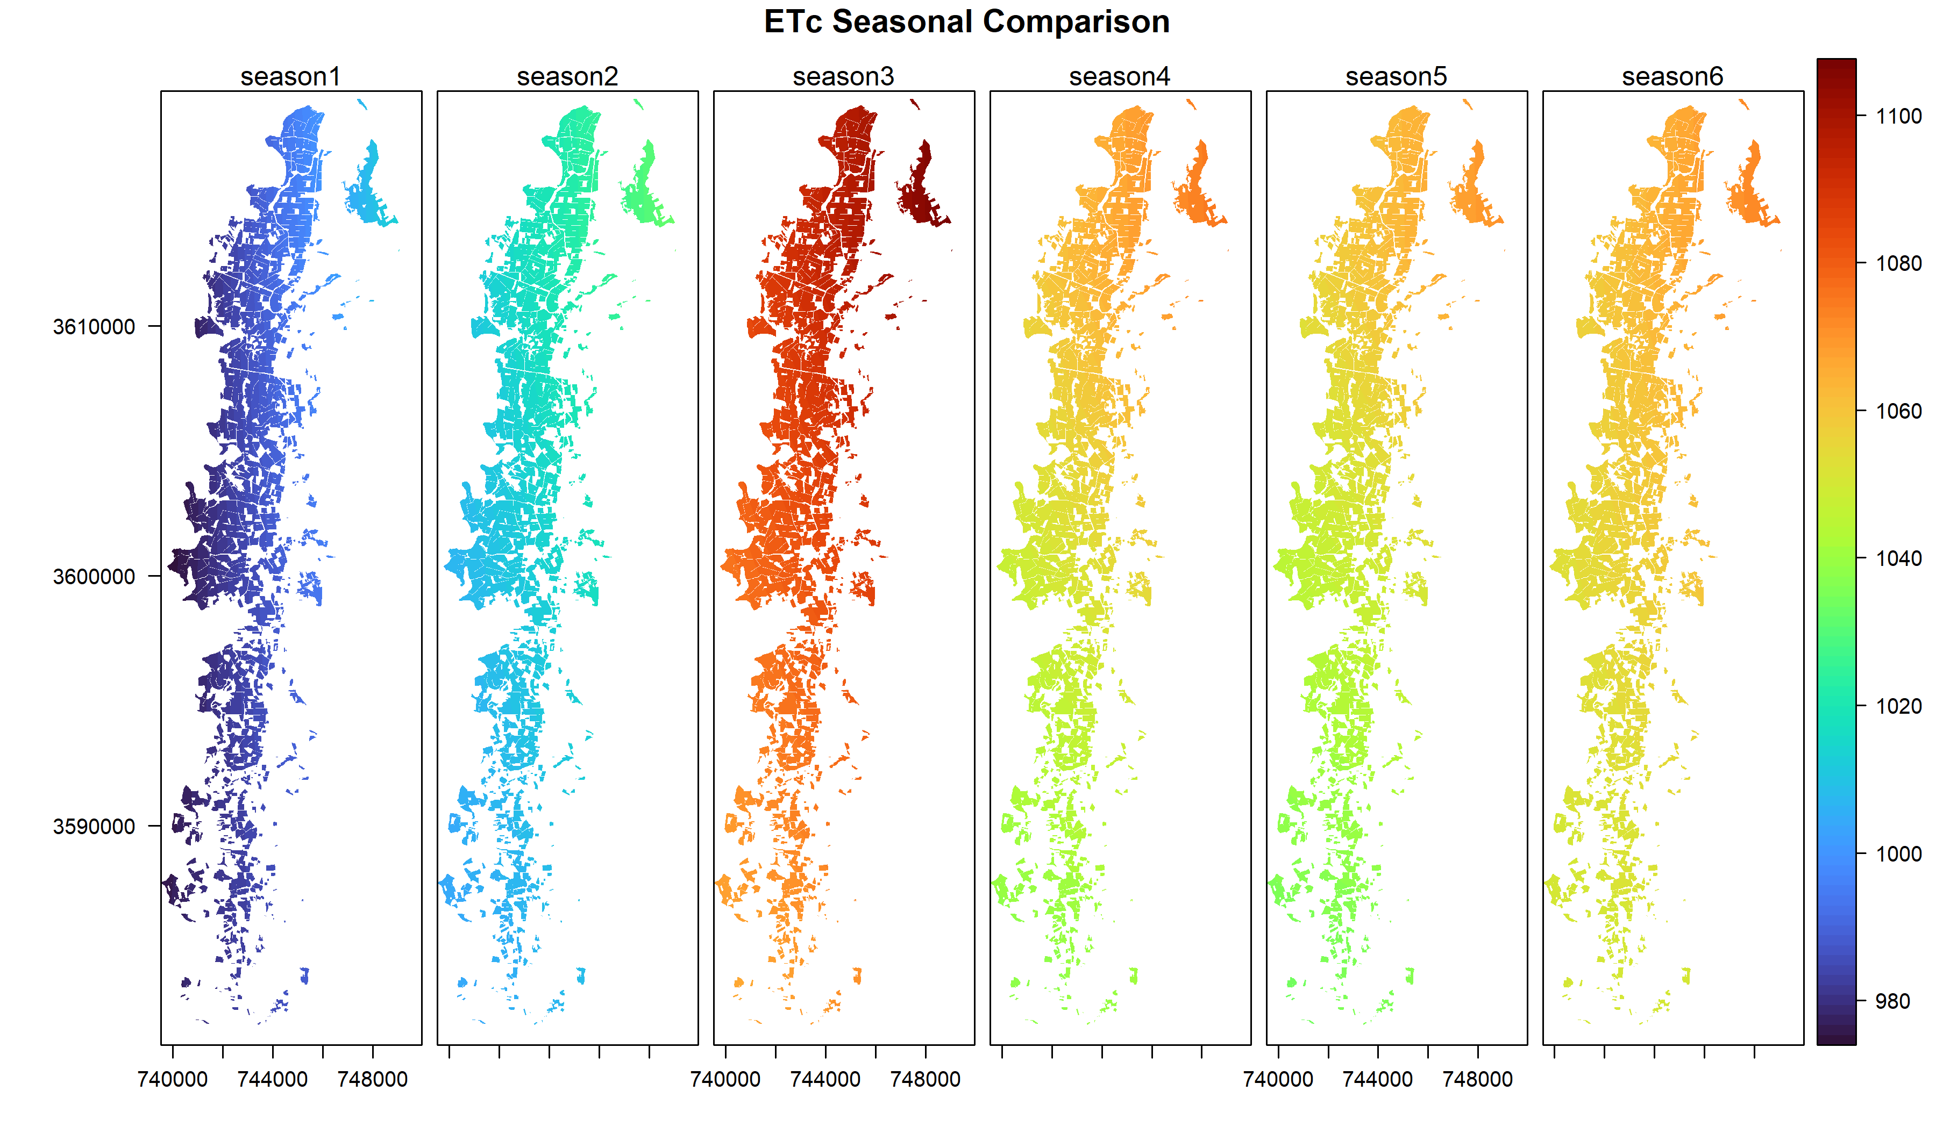

Slide 8
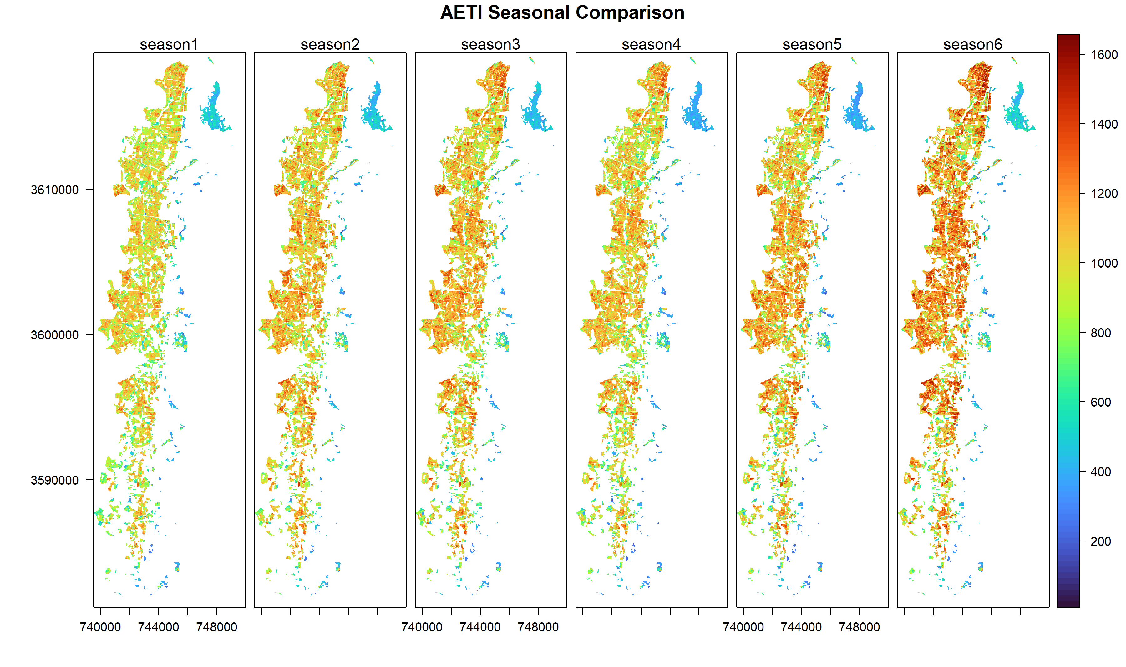

Slide 9
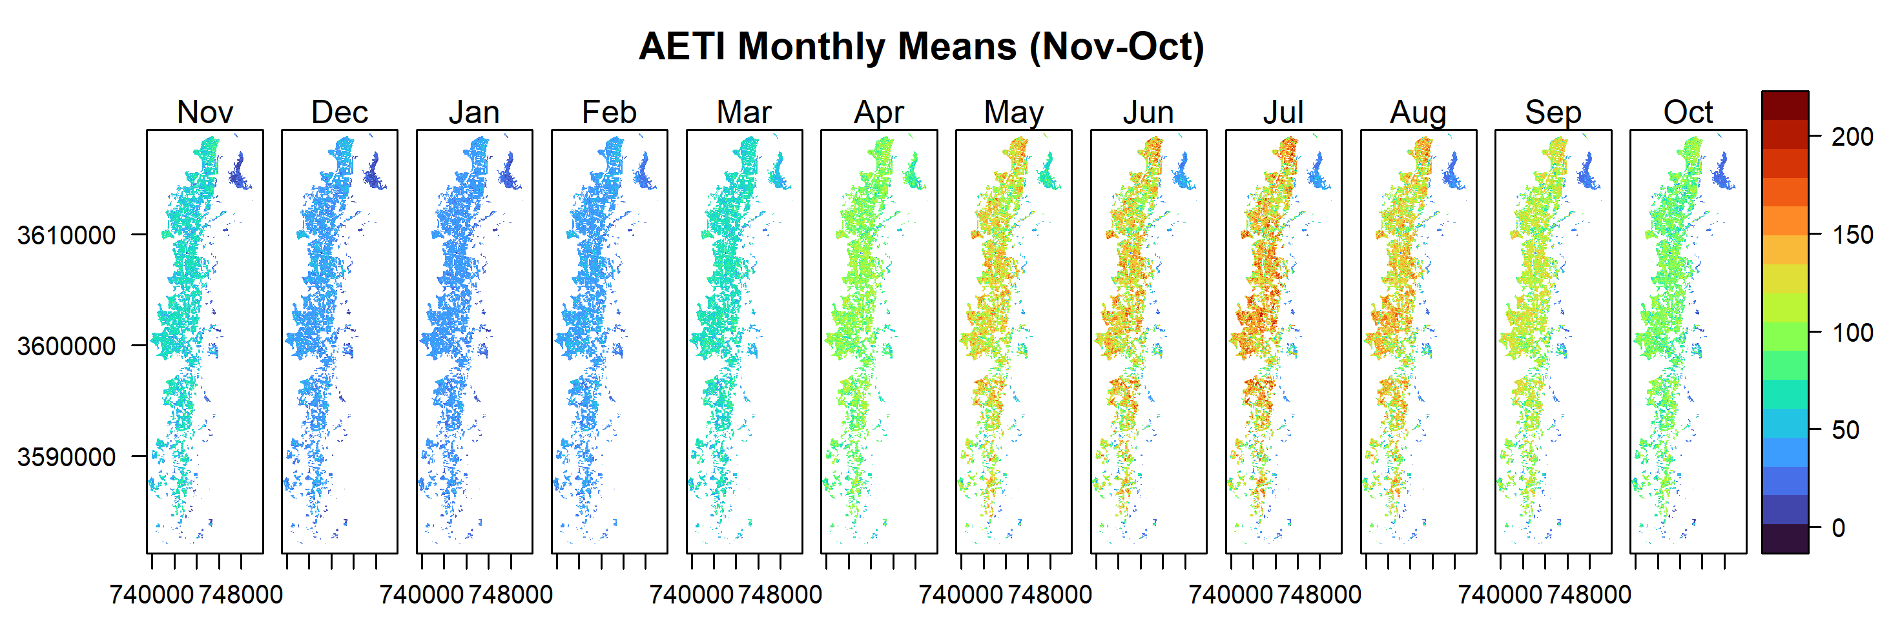
Monthly mean
Nov-2018 to Oct-2024
Monthly variations

Slide 10
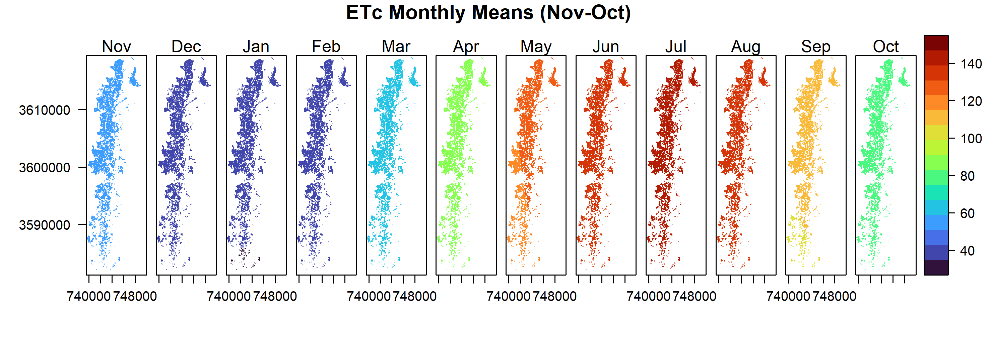
Monthly mean
Nov-2018 to Oct-2024
Monthly variations

Slide 11
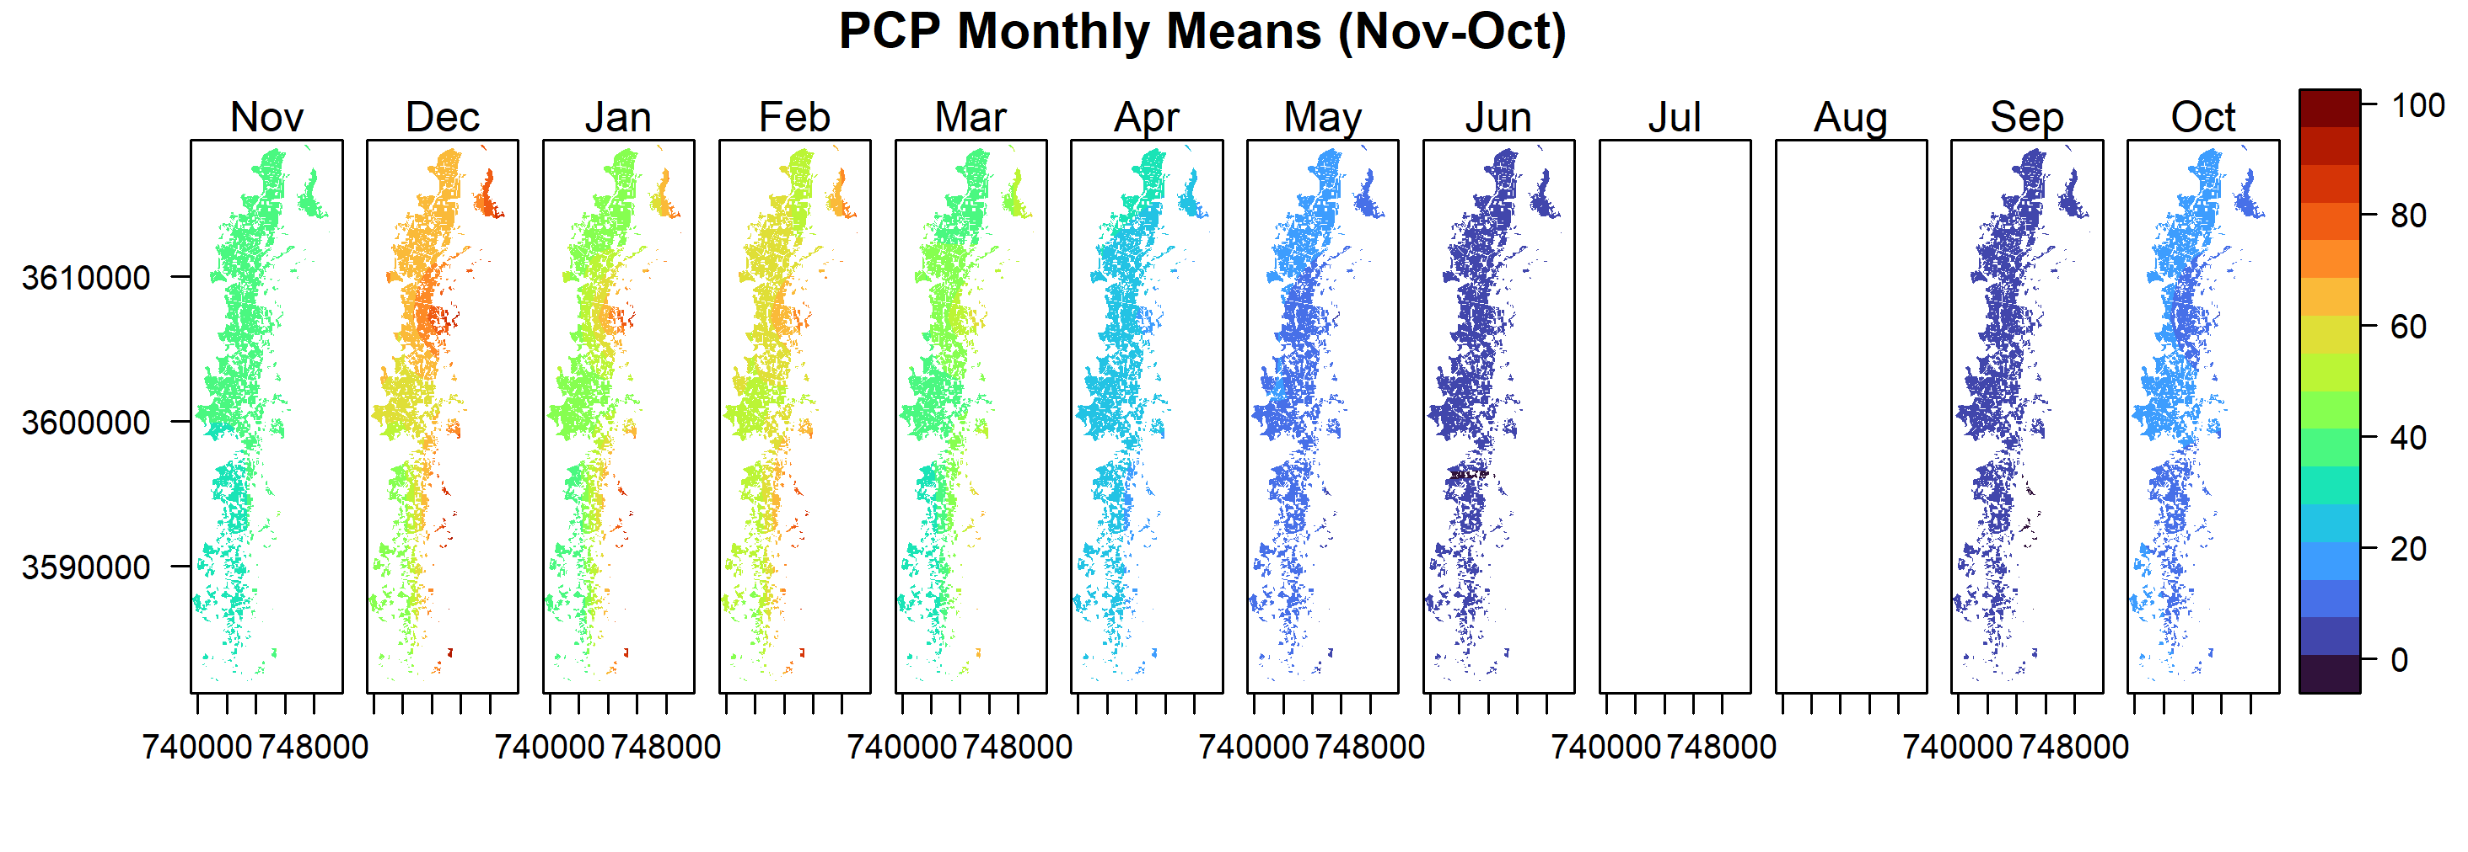
Monthly mean
Nov-2018 to Oct-2024
Zero
Monthly variations

Slide 12
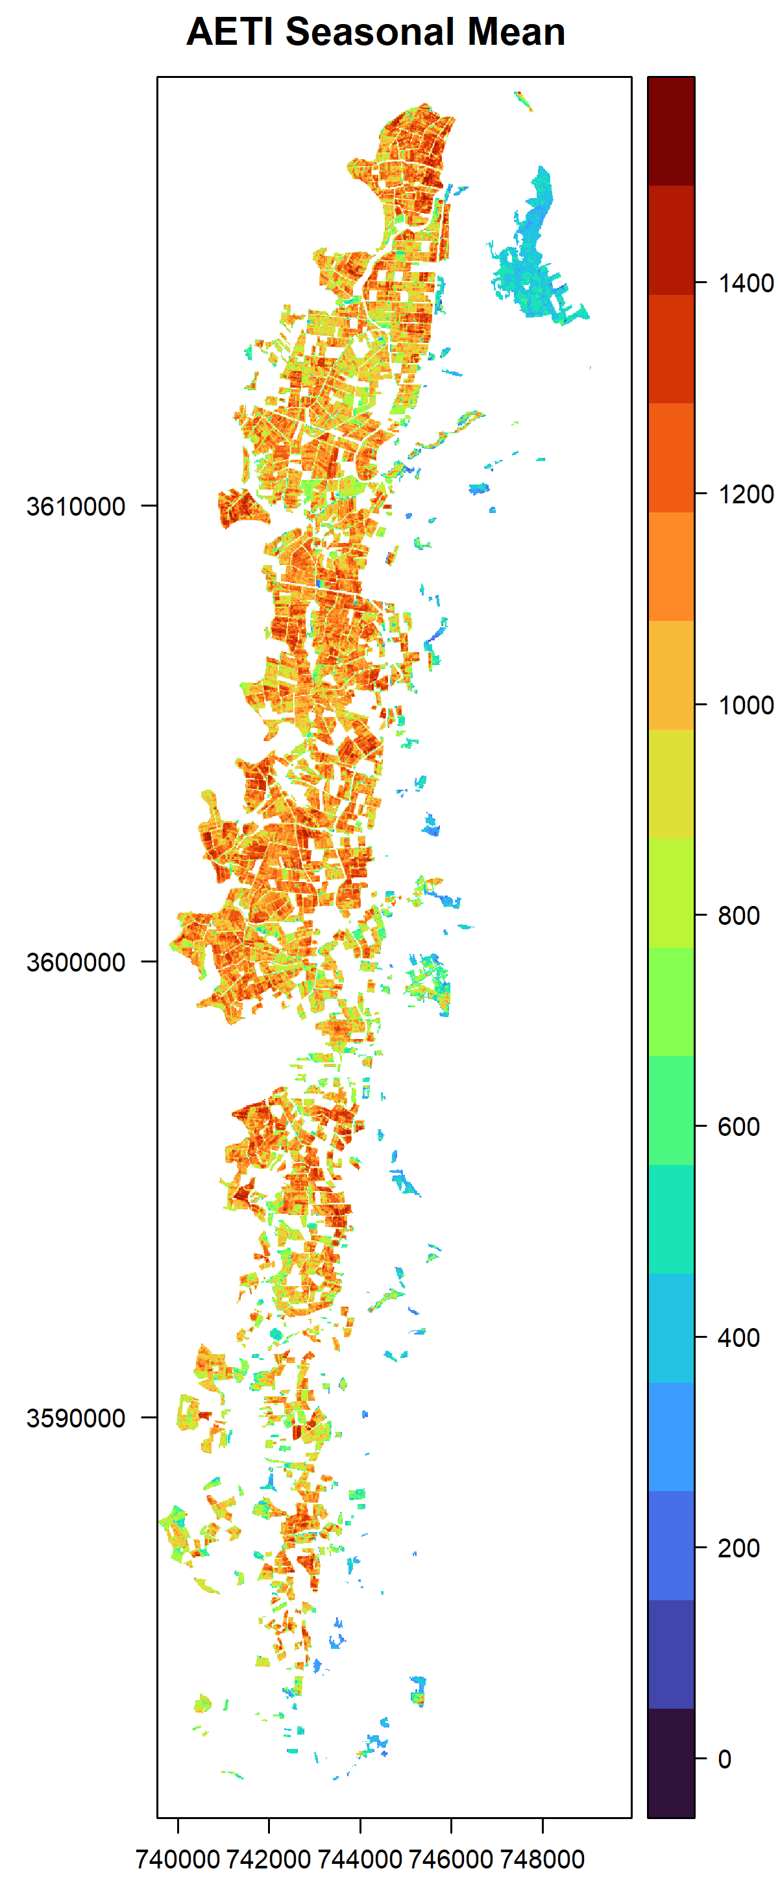
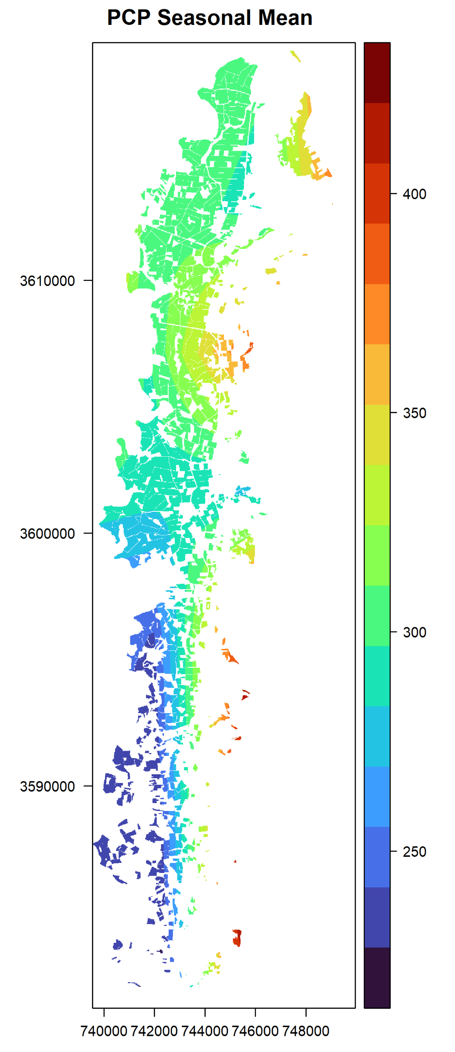
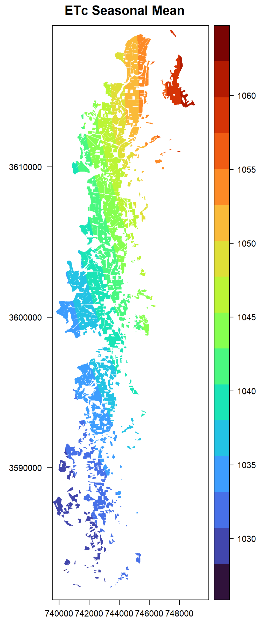
Mean Seasonal
Six seasons average: Nov-2018 to Oct 2024 ETc calculated using:
kc =[0.7, 0.65, 0.7]

Slide 13
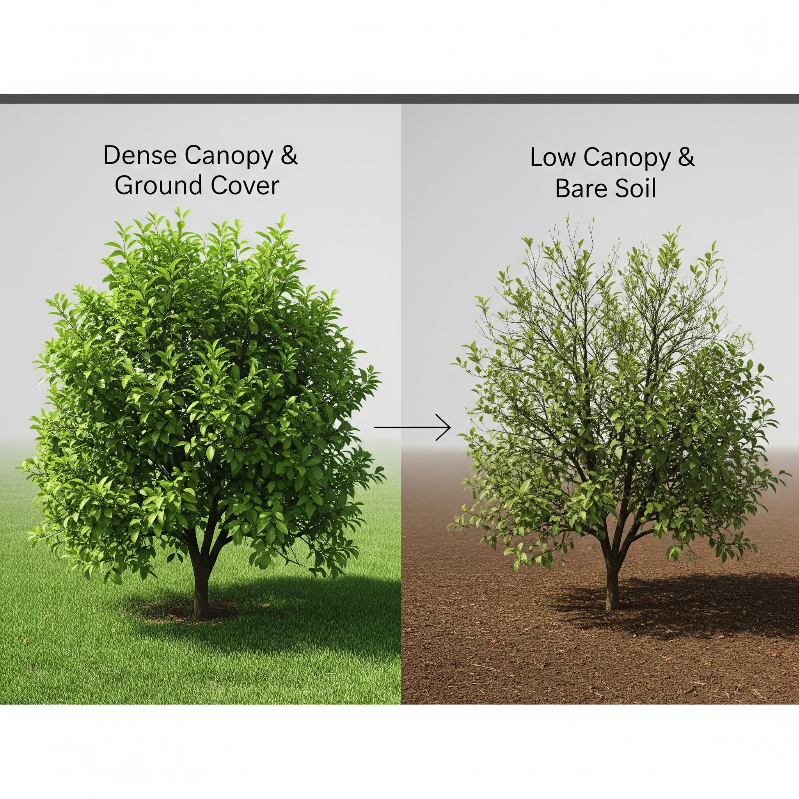
Citrus canopy
Factors affecting AETI
Tree height
Tree canopy percentage
Active ground cover under the tree

Slide 14
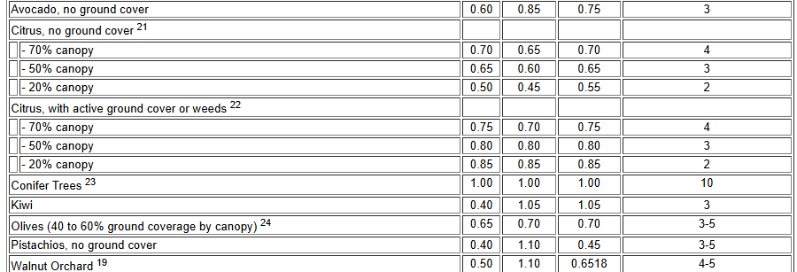
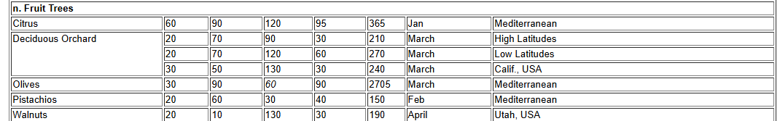
Crop Evapotranspiration (ETc):
ETc is a function of:
Canopy cover, Tree height and presence of active ground cover (weeds or mixed crops)
Source: https://www.fao.org/4/x0490e/x0490e0b.htm#chapter%206%20%20%20etc%20%20%20single%20crop%20coefficient%20(kc)

Slide 15
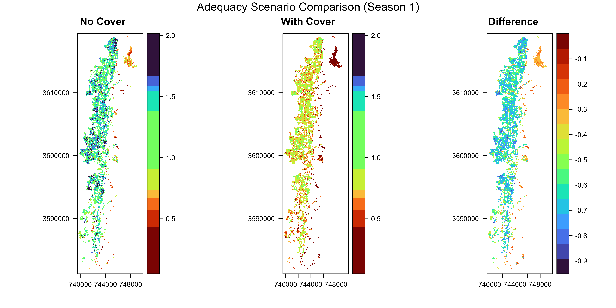

Adequacy
Adequacy$=\frac{Seasonal AETI}{Seasonal ETc}$
20% canopy,
height=2 m
Affect adequacy calculations
kc =[init, mid, end]
kc =[0.5, 0.45, 0.55]
kc =[0.85, 0.85, 0.85]

Slide 16
Conclusion
WaPOR datasets (PCP, RET, AETI) enabled seasonal and monthly analysis of citrus water consumption from 2018–2024.
ETc calculations revealed how tree canopy cover, tree height and ground active cover can influence water requirements and irrigation performance indicators such as adequacy.
Remote sensing insights needs to be complemented by field-level data to explain why performance varies across farms (validation).
Farm-level questionnaires should focus on variables that remote sensing cannot capture directly, such as:
Irrigation schedules and methods (drip, flood, etc.)
Field management practices
Perceptions of water stress and adequacy
Socio-economic drivers of field management decisions
Integration of WaPOR data with survey data will allow a more holistic understanding of water productivity and help design targeted interventions for NJV citrus farmers.

Slide 17
Thanks

