Slide 1


Combining Remote Sensing-Based Water Productivity Assessment with Economic Analysis
Sept 3, 2025
Amman, Jordan
Main drivers of water productivity in citrus production in the Northern Jordan Valley
Dr. Emad Al-Karablieh
School of Agriculture, The University of Jordan

Slide 2
Objectives
Understanding the main variables influencing water consumption and value creation citrus
Analyze citrus crop area, production, and yield trends in the Northern Jordan Valley (2010–2024).
Assess water productivity (WP) and economic performance across citrus varieties.
Identify key agronomic, institutional, and market drivers influencing efficiency and value creation.
Derive policy and farm-level recommendations for improving citrus sector sustainability under water scarcity.

Slide 3
Citrus Crop Area Trends in NJV (2010–2024)
  Citrus area grew 6.6% (2010–2024), driven by lemons (+33.8%) & local oranges.
  Clementines (-9.3%), mandarins (-29.3%) & grapefruit (-22.5%) declined.
  Pummelo grew slightly (+6.1%).
  Shifts indicate changing market demand & crop preferences.

Slide 4
Lemons
Increasing Trends of Cultivated Areas over Time

Slide 5
Lemons Cultivated Areas by Governorate in (du)
Governorate | 2010 | 2020 | 2022 | 2024
Ajloun | 122 | 270 | 270 | 270
Amman | 94 | 122 | 122 | 122
Aqaba | 175 | 115 | 140 | 141
Balqa | 358 | 404 | 404 | 404
NJV | 13,264 | 16,886 | 17,273 | 17,747
SJV | 460 | 425 | 468 | 566
MJV | 1,663 | 996 | 1,206 | 1,230
Safi | 27 | 84 | 85 | 87
Irbid | 140 | 869 | 948 | 1,019
Jarash | 699 | 1,951 | 2,176 | 2,235
Karak | 26 | 66 | 1,036 | 1,057
Ma'an | 109 | 1 | 1 | 1
Madaba | 3 | 42 | 42 | 42
Mafraq | 8 | 14 | 14 | 14
Tafiela | 0 | 27 | 137 | 3,413
Zarqa | 190 | 230 | 238 | 256
Grand Total | 17,336 | 22,501 | 24,557 | 28,603

Slide 6
Lemons
Increasing Trends of Lemon Production

Slide 7
Lemon production in both NJV and Jordan shows an increasing trend
Lemon production shows a fluctuating but generally increasing trend, sharp growth after 2022, peaking in 2024.

Slide 8
Lemons

Slide 9
Trends of Lemons Trees
(Total and Bearing Trees)

Slide 10
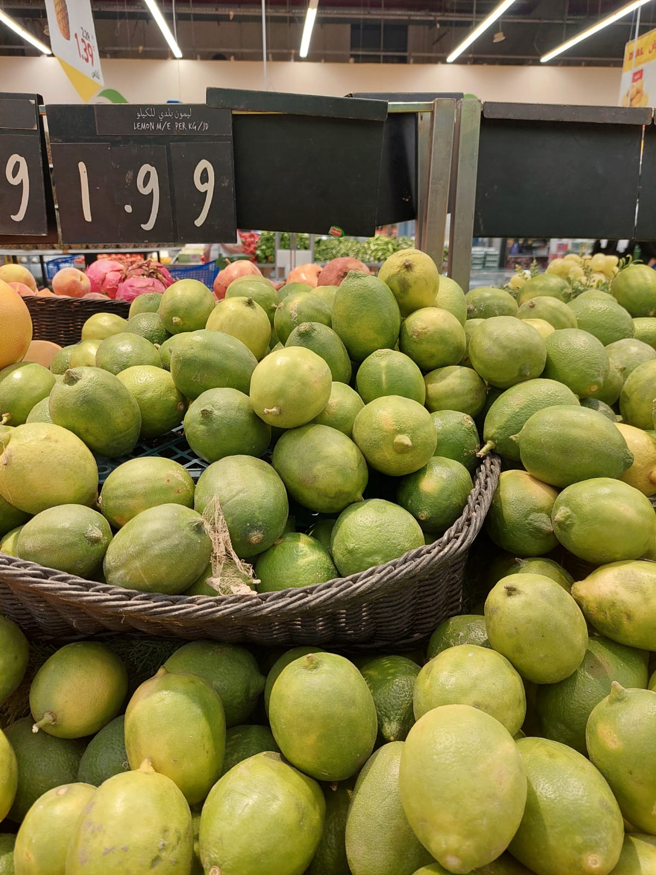
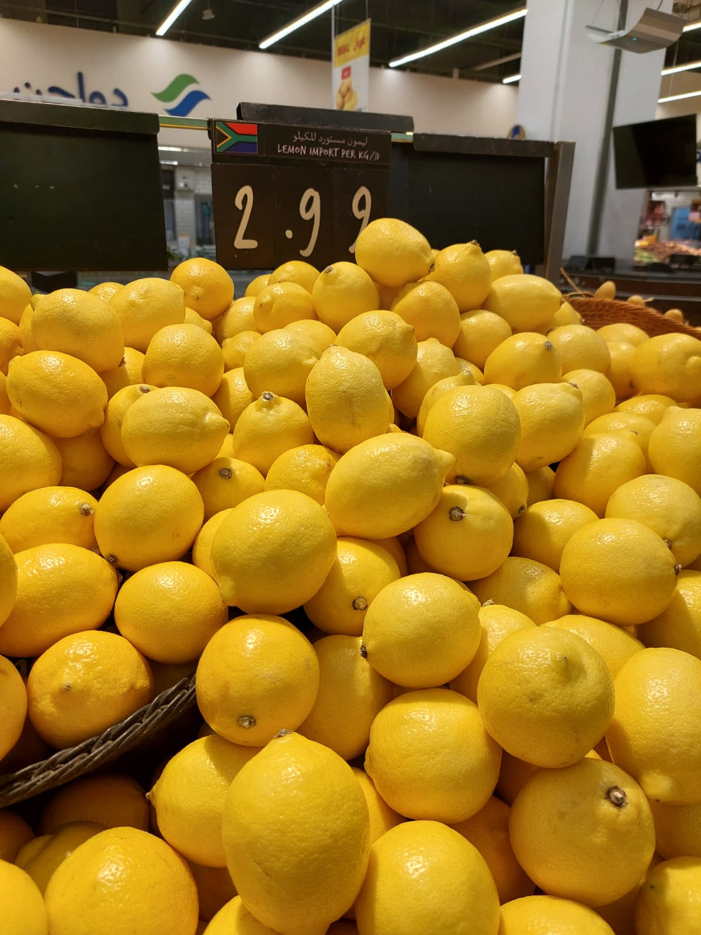
Trends of Lemon Prices

Slide 11
Monthly Lemon Farm Gate Price (JD/ton)

Slide 12
Lemon Production Trends in NJV (2010–2024)
1. Area & Tree Dynamics
Total area increased steadily from 13,264 dunums (2010) to 17,747 dunums (2024) (+33.8%).
Non-bearing area surged after 2014, peaking at 6,684 dunums in 2022, indicating recent orchard expansion.
2. Production & Yields
Production grew from 24,896 tons (2010) to 42,550 tons (2024) (+71%).
Yield per bearing dunum improved from 1,909 kg to 3,260 kg (+70.8%).
Yield per bearing tree increased from 60 kg to 95 kg.
3. Tree Numbers & Density
Bearing trees grew from 415,831 in 2010 to 450,000 in 2024.
Total trees increased markedly to 611,796 in 2024, with ~34 trees/dunum density.
Key Insights
Strong upward trend in both area and productivity, driven by orchard renewal & improved agronomic practices.
Expansion in non-bearing areas suggests continued future production growth.
Yield gains per tree indicate better management, possibly linked to irrigation and fertilizer use efficiency.

Slide 13
Stability of Oranges Cultivated Areas

Slide 14
Trends of Orange Production (ton)

Slide 15
Trends of Orange Trees

Slide 16
Navel Orange Production Trends (2010–2024)
1. Area & Orchard Structure
Total area increased from 10,169 dunums (2010) to 11,926 dunums (2024) (+17.3%).
Bearing area declined from 2010 to 2021, then partially recovered, stabilizing at 9,137 dunums in 2023–2024.
Non-bearing area expanded after 2018, peaking at 3,201 dunums (2022), showing recent replanting/expansion.
2. Production & Yields
Production rose from 14,972 tons (2010) to a peak of 30,612 tons (2023), before settling at 22,846 tons (2024).
Yield per bearing dunum increased from 1,654 kg to 2,500 kg in 2024, peaking at 3,350 kg in 2023.
Yield per bearing tree rose from 51 kg to 71 kg, peaking at 96 kg in 2023.
3. Tree Numbers & Density
Bearing trees fluctuated, starting at 291,513 in 2010, reaching 320,000 in 2023–2024.
Tree density increased from 32 to 35 trees/dunum.
Key Insights
Moderate area growth, but substantial yield improvement due to orchard rejuvenation and improved management.
2023 marks an exceptional yield spike, possibly from favorable climate or improved inputs.
High non-bearing area suggests further production growth potential in coming years.

Slide 17
Citrus Economics in NJV
Crop | Production (ton) | Area (du) | Rough Yield (ton/du) | Total Number of Trees | Number of Bearing Trees | Trees per du (no/du) | Fruitful Area (du) | Yield of Fruitful Area (ton/du) | Yield per Fruitful Tree | Farm Gate Price (JD/ton) | Total Revenues (JD/du) | Gross WP (JD/m3)
Lemons | 42,550 | 17,747 | 2.40 | 611,796 | 450,000 | 34.5 | 13,054 | 3.26 | 94.56 | 339 | 1,103 | 1.38
Oranges, local | 3,479 | 1,829 | 1.90 | 60,565 | 51,500 | 33.1 | 1,555 | 2.24 | 67.56 | 466 | 1,043 | 1.30
Oranges, navel | 22,846 | 11,926 | 1.92 | 417,674 | 320,000 | 35.0 | 9,137 | 2.50 | 71.39 | 466 | 1,165 | 1.46
Oranges, red | 12,136 | 3,912 | 3.10 | 129,199 | 127,000 | 33.0 | 3,846 | 3.16 | 95.56 | 466 | 1,470 | 1.84
Oranges, valencia | 3,582 | 1,796 | 1.99 | 58,880 | 57,250 | 32.8 | 1,746 | 2.05 | 62.56 | 466 | 956 | 1.19
Oranges, french | 2,012 | 1,702 | 1.18 | 58,318 | 38,500 | 34.3 | 1,123 | 1.79 | 52.27 | 466 | 835 | 1.04
Oranges, shamouti | 5,519 | 2,976 | 1.85 | 98,803 | 86,500 | 33.2 | 2,606 | 2.12 | 63.81 | 466 | 987 | 1.23
Clementines | 15,618 | 10,190 | 1.53 | 330,208 | 298,000 | 32.4 | 9,196 | 1.70 | 52.41 | 568 | 965 | 1.21
Mandarins | 6,755 | 3,687 | 1.83 | 119,249 | 114,000 | 32.3 | 3,525 | 1.92 | 59.25 | 492 | 944 | 1.18
Grapefruits | 1,591 | 1,363 | 1.17 | 44,633 | 43,700 | 32.7 | 1,335 | 1.19 | 36.40 | 344 | 410 | 0.51
Medn. mandarins | 157 | 78 | 2.03 | 2,385 | 2,385 | 30.8 | 78 | 2.03 | 66.00 | 492 | 1,000 | 1.25
Pummelors | 3,999 | 2,453 | 1.63 | 87,685 | 57,000 | 35.7 | 1,595 | 2.51 | 70.16 | 682 | 1,710 | 2.14
Grand Total | 120,245 | 59,659 | 2.02 | 2,019,395 | 1,645,835 | 33.8 | 48,623 | 2.47 | 73.06 | 476 | 1,049 | 1.31

Slide 18
An Aggregate Water Productivity
Crop | Productivity of Water (Kg/m3) | WUE, Gross Output (JD/M3) | Water Gross Margin (JD/m3) | Water Gross Value Added (JD/m3) | Water Net Value Added (JD/m3) | Net Profitability (FAP) (JD/m3) | Percent cost of Water from total cost | Applied Water Quantity (M3/du)
Lemons | 7.93 | 2.65 | 1.45 | 1.40 | 1.32 | 1.17 | 0.7% | 600
Oranges, local | 4.32 | 2.20 | 1.50 | 1.48 | 1.42 | 1.33 | 1.1% | 769
Oranges, navel | 3.36 | 1.63 | 0.89 | 0.86 | 0.79 | 0.68 | 1.0% | 676
Oranges, red | 3.12 | 1.63 | 0.75 | 0.71 | 0.64 | 0.53 | 0.9% | 676
Oranges, valencia | 5.17 | 2.79 | 1.87 | 1.83 | 1.76 | 1.63 | 0.9% | 600
Oranges, french | 3.34 | 1.84 | 0.79 | 0.75 | 0.67 | 0.55 | 0.8% | 600
Oranges, shamouti | 3.36 | 1.71 | 0.64 | 0.59 | 0.52 | 0.39 | 0.8% | 600
Clementines | 2.80 | 1.60 | 0.45 | 0.40 | 0.33 | 0.20 | 0.7% | 600
Mandarins | 2.29 | 1.14 | 0.49 | 0.47 | 0.40 | 0.30 | 1.2% | 757
Grapefruits | 3.19 | 1.45 | 0.63 | 0.59 | 0.53 | 0.42 | 1.0% | 660
Medn. mandarins | 2.38 | 0.84 | 0.38 | 0.37 | 0.30 | 0.18 | 1.5% | 800
Pummelors | 2.77 | 1.66 | 0.80 | 0.76 | 0.69 | 0.58 | 0.9% | 690
Average | 6.43 | 2.46 | 1.45 | 1.42 | 1.34 | 1.20 | 0.02 | 668

Slide 19
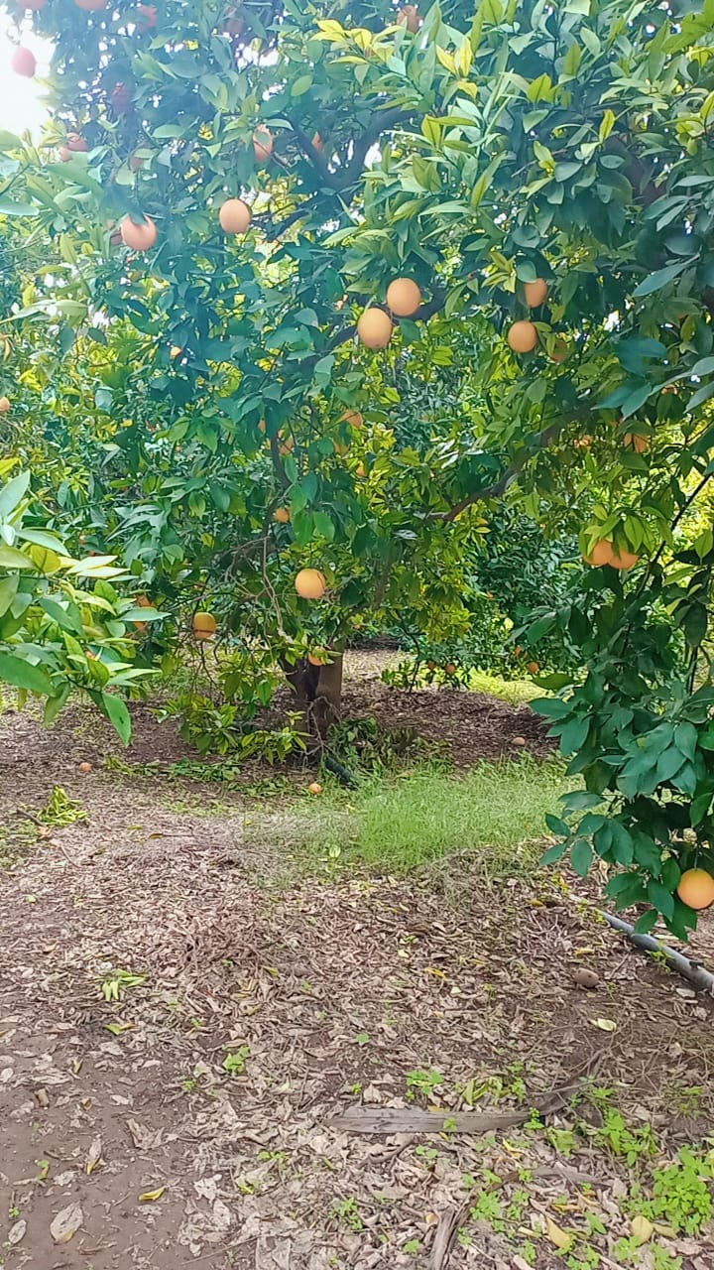
3. Top Performing Crops
Lemons
  Largest production: 42,550 tons (35% of total citrus).
  Highest number of trees: 611,796 (450,000 bearing).
  Yield: 2.40 ton/du (below overall citrus average).
  Gross WP: 1.38 JD/m³.
  Importance: backbone of NJV citrus sector.
Oranges (Navel)
  Production: 22,846 tons (19%).
  Yield: 1.92 ton/du.
  Gross WP: 1.46 JD/m³ (above average).
  Economically important alongside lemons.
Clementines
  Production: 15,618 tons (13%).
  Yield: 1.53 ton/du (lower productivity).
  Farm gate price is highest (568 JD/ton).
  Gross WP: 1.21 JD/m³ (slightly below average).

Slide 20
Intermediate Performing Crops
Oranges (Red)
Production: 12,136 tons (10%).
Highest yield per du: 3.10 ton/du.
WP: 1.84 JD/m³ (second highest).
Very efficient in terms of returns on water use.
Pummelos
Production: 3,999 tons only, but:
Very high WP: 2.14 JD/m³ (highest among citrus).
Highest farm-gate price: 682 JD/ton.
Niche crop, high value per unit area and water.

Slide 21
3. Lower Performing Crops
Grapefruits
  Production: 1,591 tons (1.3%).
  Lowest yield per du: 1.17 ton/du.
  Lowest WP: 0.51 JD/m³.
  Economically uncompetitive.
Oranges (French & Valencia)
  Low yield (1.18–1.99 ton/du).
  Low WP (1.04–1.19 JD/m³).
  Not attractive under water-scarce conditions.

Slide 22
Water Productivity (WP) Insights
Above-average WP crops (>1.31 JD/m³):
  Pummelos (2.14), Oranges Red (1.84), Navel (1.46), Lemons (1.38).
Below-average WP crops:
  Grapefruits (0.51), French oranges (1.04), Valencia (1.19).
This suggests that in water-scarce conditions, expanding pummelos, red oranges, and navel oranges is preferable, while reducing grapefruits, French oranges, and Valencia oranges.

Slide 23
Key Insights:
Overall Growth in Citrus Area:
  Total citrus area increased from 55,950 ha (2010) to 59,659 ha (2024) — about 6.6% growth over 14 years.
Lemons:
  Significant and steady expansion from 13,264 ha in 2010 to 17,747 ha in 2024 (+33.8%).
Oranges:
  Total orange area grew from 22,121 ha to 24,140 ha (+9.1%).
  Local varieties saw a major rise after 2016 (from 510 ha to 1,829 ha in 2024).
  Navel and Valencia varieties remained relatively stable.
  Shamouti and French varieties declined slightly.
Clementines & Mandarins:
  Clementine area decreased from 11,227 ha (2010) to 10,190 ha (2024).
  Mandarin area dropped sharply from 5,213 ha to 3,687 ha.
Grapefruit & Pummelo:
  Grapefruit area decreased from 1,758 ha (2010) to 1,363 ha (2024).
  Pummelo area increased modestly from 2,312 ha to 2,453 ha.
Conclusion:
The citrus sector is experiencing moderate overall growth driven by lemons and local oranges.
Some varieties (mandarins, grapefruits, clementines) are losing ground, indicating possible market or climate-driven shifts in cultivation preferences.

Slide 24
Policy and Economic Implications
Diversification: Lemons dominate, but heavy dependence creates risk; diversification toward higher WP crops like red oranges and pummelos is advisable.
Market-driven decisions: Clementines and pummelos fetch high farm-gate prices, indicating strong market demand.
Water efficiency: WP differences highlight the need for reallocation towards crops that generate higher economic returns per m³.

