Slide 1
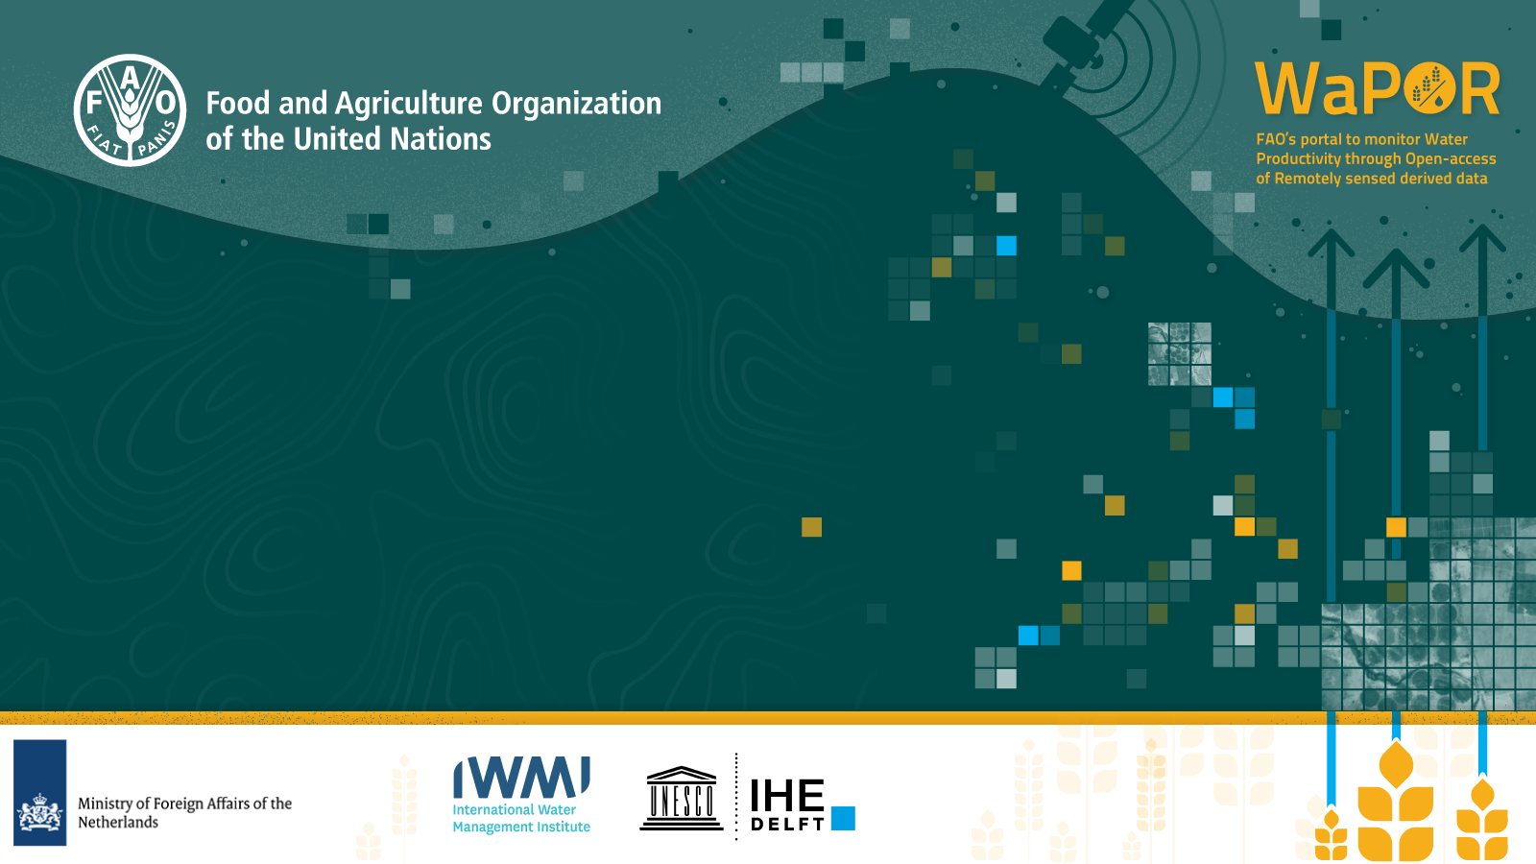
Monitoring land and water productivity by Remote Sensing (WaPOR phase 2)
FAO Land and Water, wapor@fao.org
Notes:
WaPOR stands for Water Productivity monitoring through Open access of remotely sensed derived data. The WaPOR programme is innovative in the sense that we are using information coming directly from satellites to help farmers and policy makers in improving water management for crop production.

Slide 2

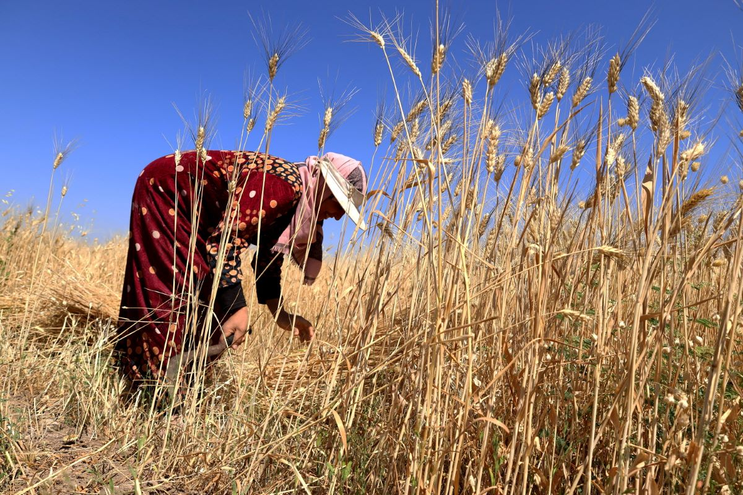
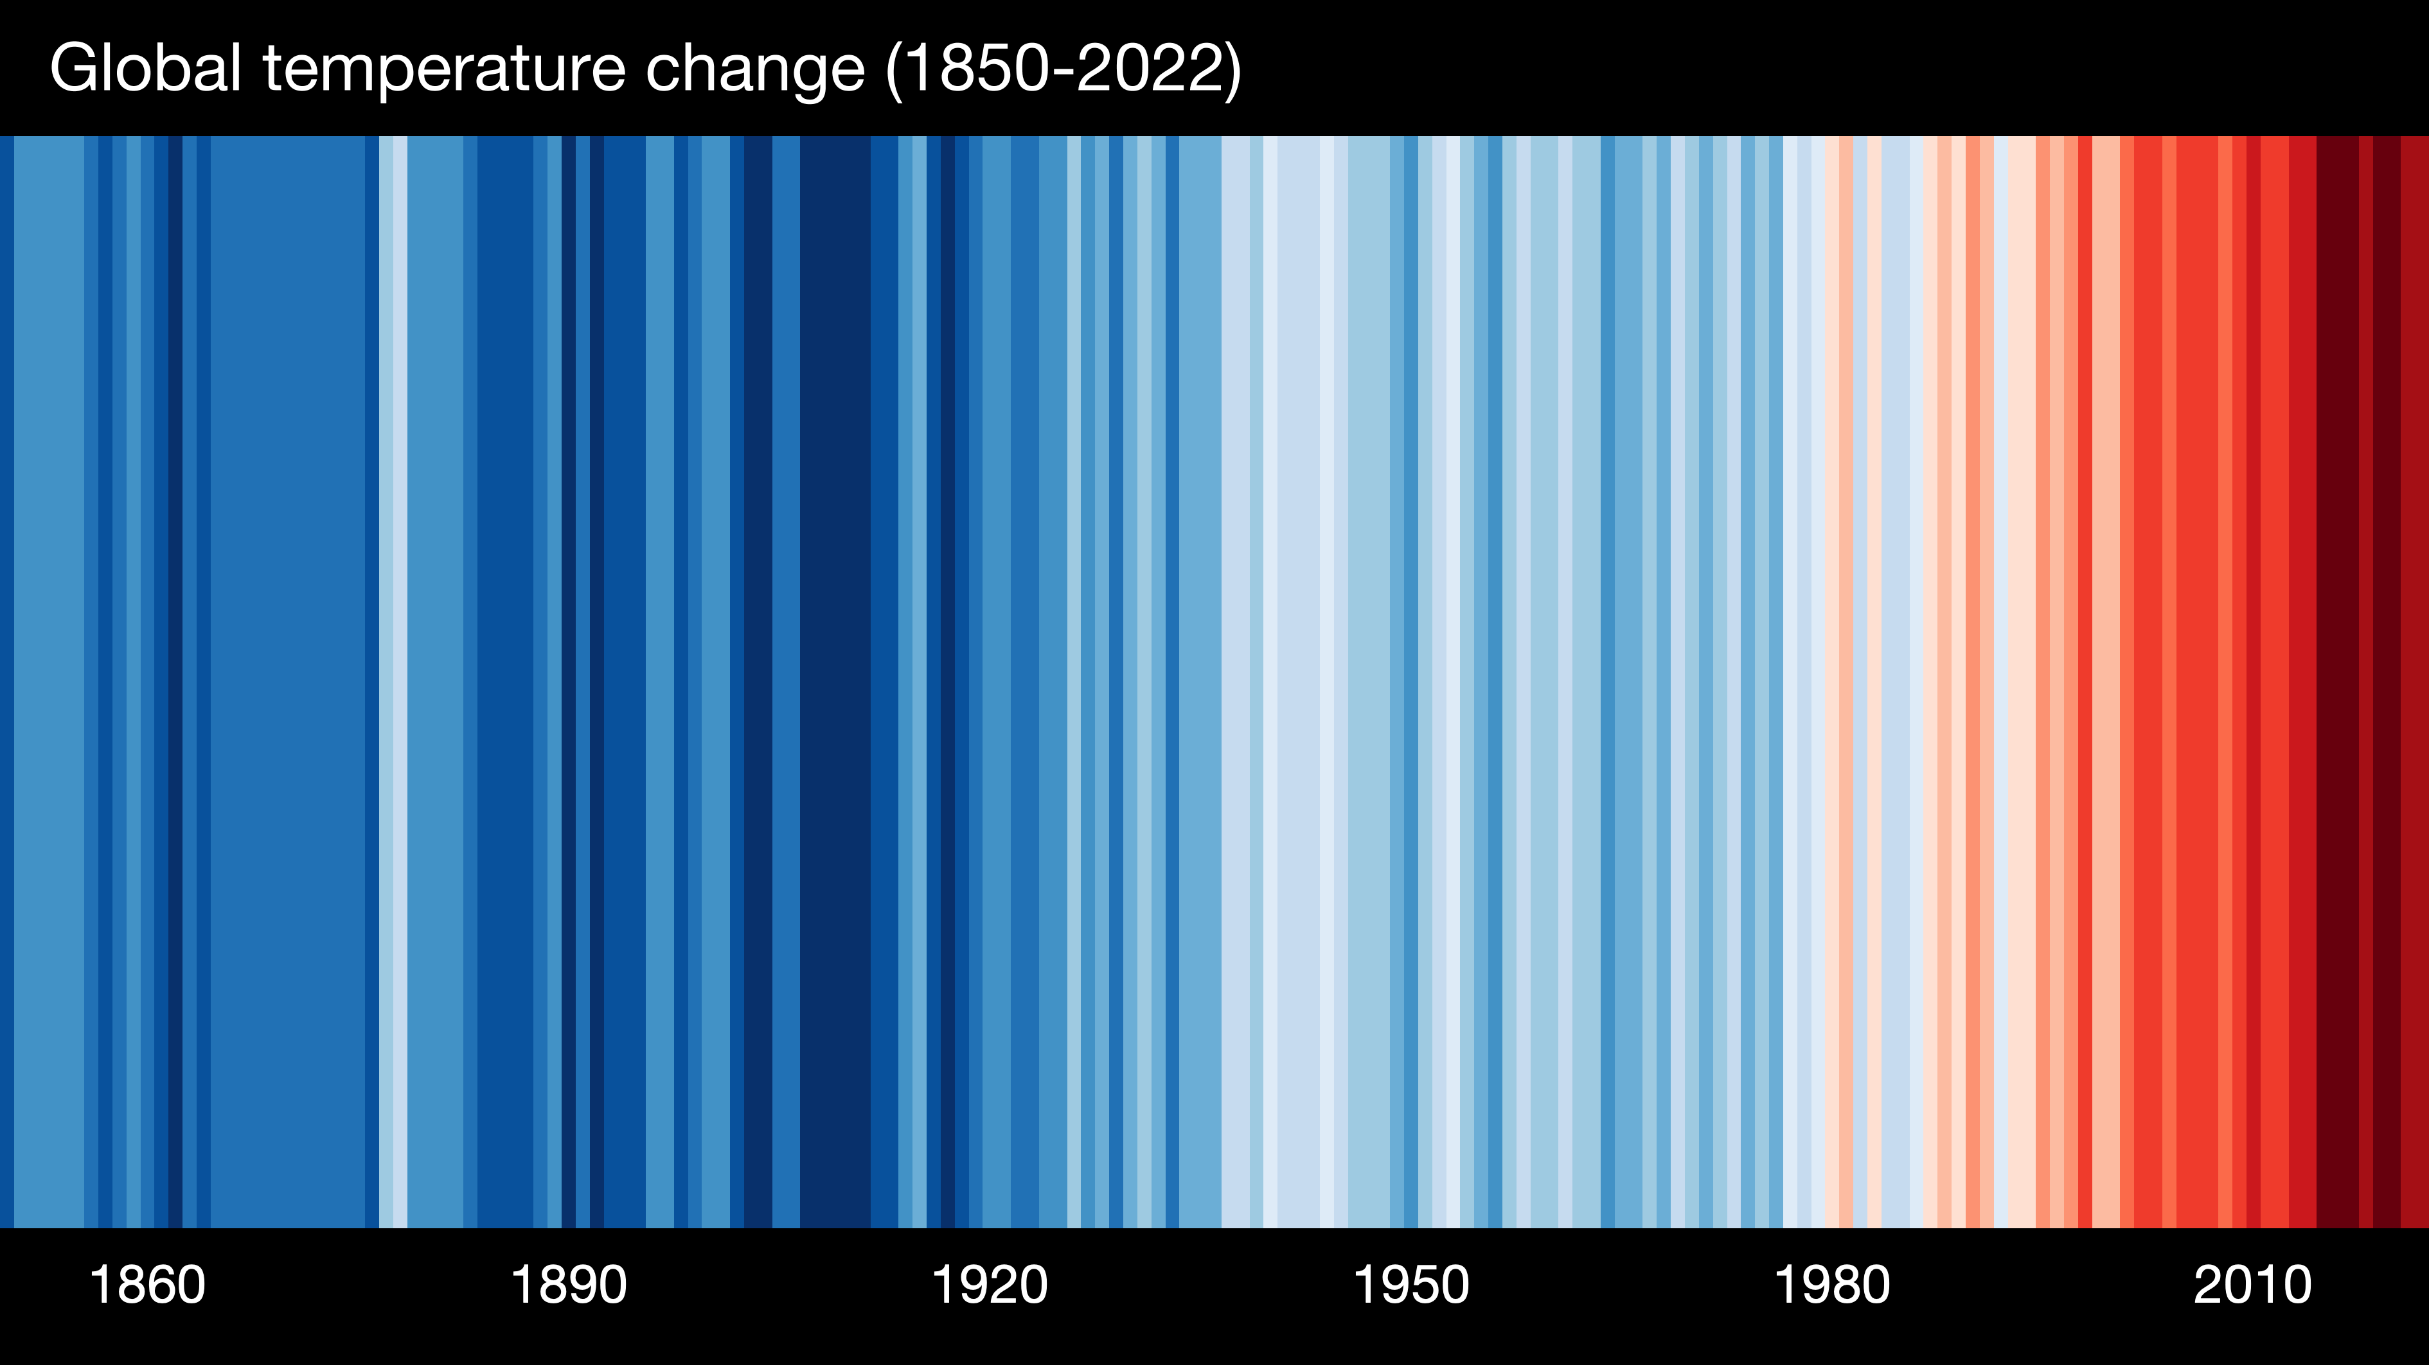
Over 700 million people suffer from hunger
(SOFI 2023)
Around 3.2 billion people live in agricultural areas with high to very high water shortages or scarcity
(SOFA 2020)
Water demand by agriculture is projected to increase by 20 - 30% by 2050, and
From 2000 – 2019 total cropland increased with 63 M ha, almost 85% of this increase is irrigated
(SOLAW 2022)
Water is central to food security and climate agenda
Notes:
Here you see a few quotes from FAO flagship publications:
The first quote comes from FAO’s yearly flagship publication “The state of Food Security and nutrition”,
The figure that you see here refers to 2021. 46 million people more from a year earlier when then were less than 800 people suffering from food insecurity and 150 million more from 2019 when this figure was still below the 700 Million people.
The second quote comes from another FAO flagship publication on the State of Food and Agriculture which shows that Achieving sustainable development still faces a key challenge: 3.2 billion people live in agricultural areas with high to very high water shortages or scarcity, of whom 1.2 billion people – roughly one-sixth of the world’s population – live in severely water-constrained agricultural areas.
And the last two quotes come from The State of Land and Water publication (SoLaW) published by the land and Water Division.
In order to feed a growing population in 2050, global agriculture production needs to grow by 35%
This will be problematic because the pressures on land and water resources have built to the point where productivity of key agricultural systems is compromised and livelihoods are threatened.
This is also shown by the last quote, which says that over the last 10 year 85% of the increase in global cropland was irrigated.
This is not surprising because the yields under irrigation are higher than under rainfed agriculture.

Slide 3
We need to produce more food with less water
Net increase in cultivated area over the last 60 years is attributable to a net increase in irrigated cropping
At the same time, agriculture is facing growing water scarcity
Notes:
So the message is pretty clear, we will need to produce more food while using less water.
Total crop land in 1960 1350 M ha of which 150 M irrigated 11%
In 2017 1570 of which 350 M irrigated 22%

Slide 4
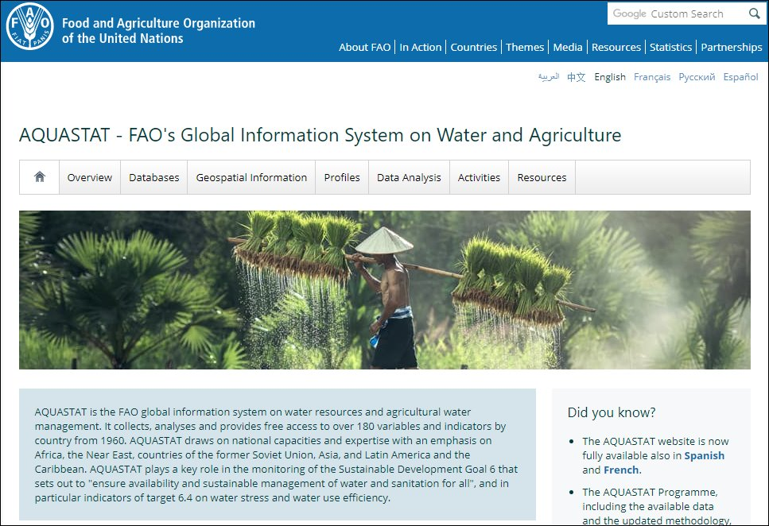
AQUASTAT
The FAO global information system on water resources and agricultural water management collects, analyses and provides free access to over 180 variables and indicators by country from 1960.
AQUASTAT data and information support SDG 6.4 indicators, for which FAO is custodian agency.
http://www.fao.org/aquastat/en/

Slide 5
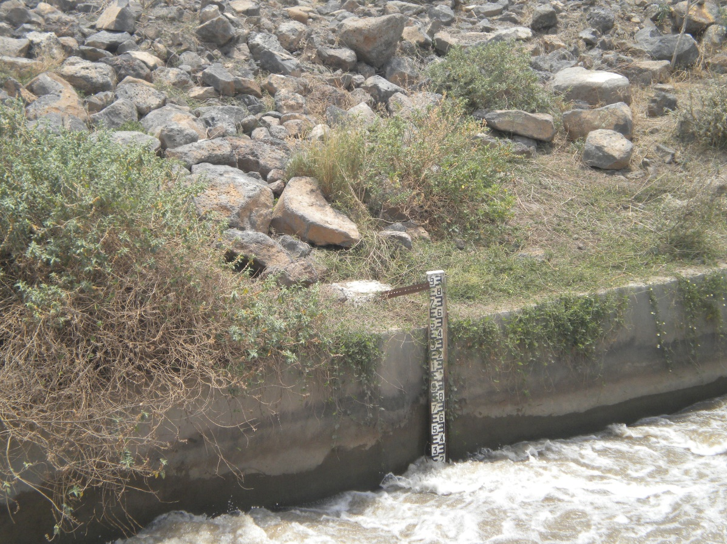
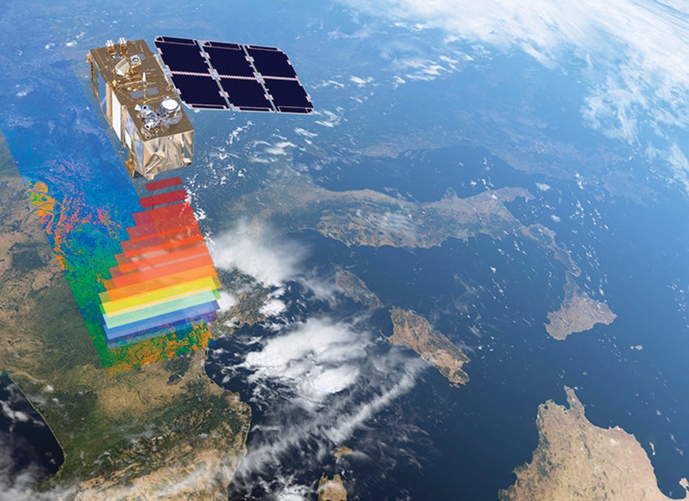
Monitoring water use in agriculture in space and time
Notes:
However, it is difficult to measure water use in agriculture. Especially if one wants to monitor large areas. And one has only very limited instruments available to measure water use as the one in this picture
[CLICK]
Satellite Remote Sensing can help us with this. We can use satellite information to assess both crop growth and water use. This way we can monitor water productivity. Which helps to monitor progress towards SDG 6.4 in using water more efficiently. Also, we can compare water productivity on field level which can help in providing advice to farmers.

Slide 6
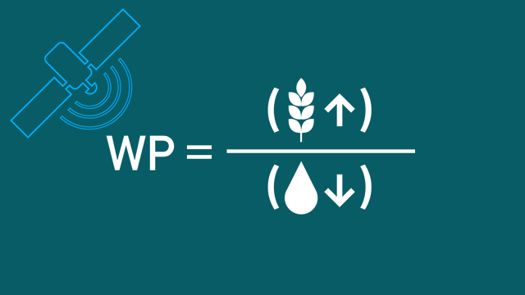
Water productivity in agriculture measures the output (kg/ha) per unit of water consumed (m³/ha).
Satellites can help monitor water productivity in cost-effective ways.
Increasing water productivity is now a globally recognized target (SDG 6.4)
Remote sensing of water productivity
Notes:
Water Productivity is an indicator that can be used to monitor at the same time progress and spatial variations in terms of land productivity (biomass and yield) and in water being consumed to obtain these yields. Both terms of the equation are important, and need to be looked at together. Making the most out of every drop of water is a target that makes sense across scales and across water users.

Slide 7






How WaPOR works
Notes:
This slide shows how WaPOR works. First, information from freely available satellite data is interpreted by using open-source models. The interpreted information on Climate, including Precipitation and Evapotranspiration, Crop growth, including Biomass production is then stored in the cloud and can be accessed through freely available programming interfaces, APIs. Users, which include policymakers, scientists and also farmers, can access the information and adapt agricultural practices to increase land and water productivity. The WaPOR programme is implemented together with the International Water Management Institute, IHE-Delft and Eleaf a private company based in the Netherlands.

Slide 8

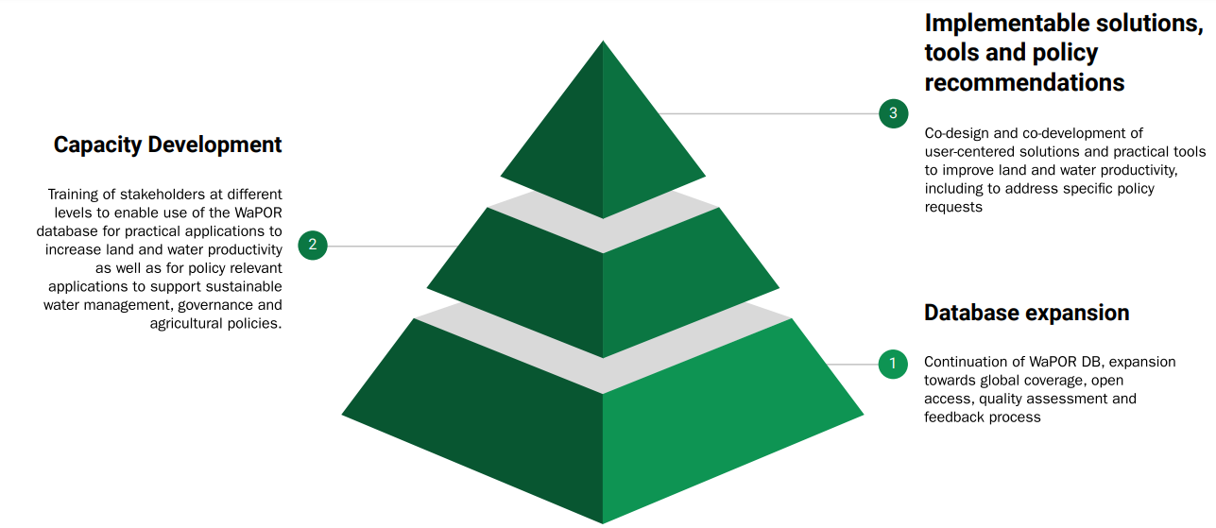
WaPOR Phase 2: demand driven applications
2 main international partners, 3 components,
5+ years,13 countries

Slide 9
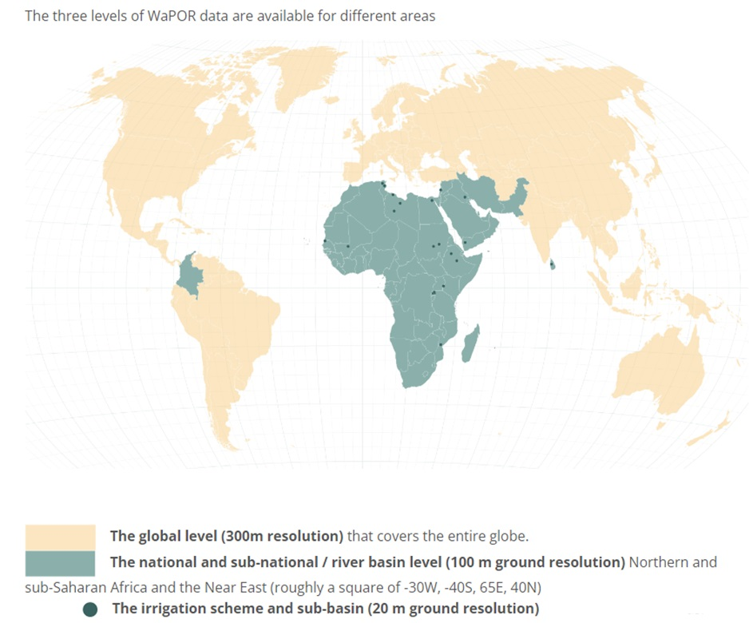
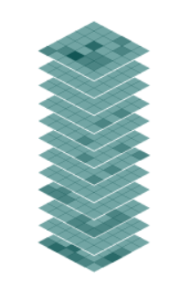
Data availability
Water Productivity
Actual Evapotranspiration (ETa)
Reference Evapotranspiration
Precipitation
Relative root zone soil moisture
Net Primary Production
Quality layers
Daily (P, RET), dekadal, monthly, annual time steps
NRT update since 2018 (2009 on V2)

Slide 10
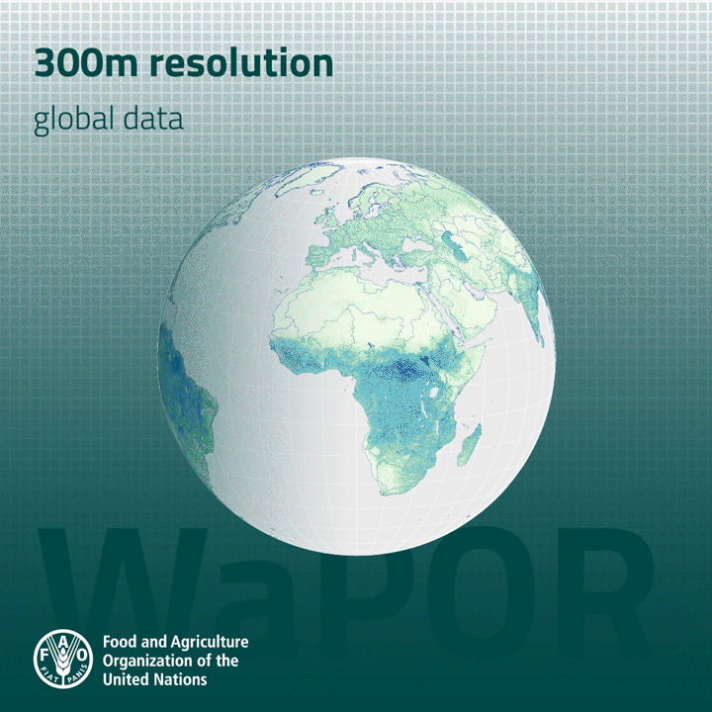
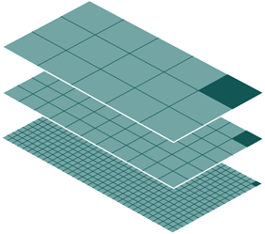
Near-real time (every 10 days) data on biomass development and water consumption (actual evapotranspiration), in addition to agro-climatic parameters on a daily time step (reference ET and precipitation).
Spatial resolution ranges between 300 m and 20 m
WaPOR provides
actionable information
300m
100m
20m

Slide 11
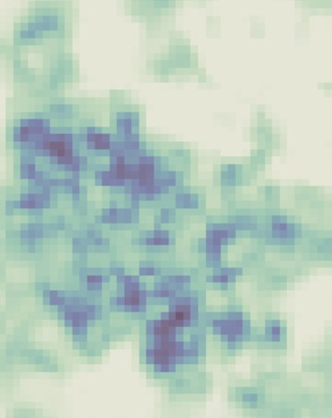
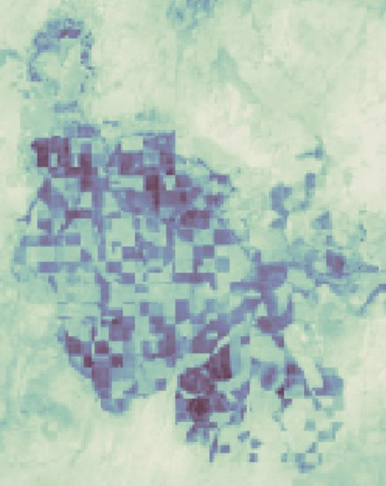
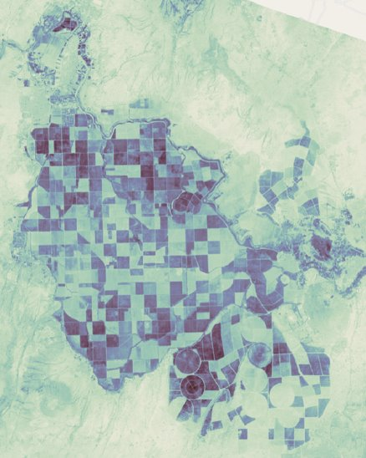

Near-real time (every 10 days) data on biomass development and water consumption (actual evapotranspiration), in addition to agro-climatic parameters on a daily time step (reference ET and precipitation).
Spatial resolution ranges between 300 m and 20 m
WaPOR provides
actionable information
300m
100m
20m
Global data 300m
National data 100m, covering Africa and Near East
Sub-national areas 20m, >25 areas of ~100,000 ha

Slide 12
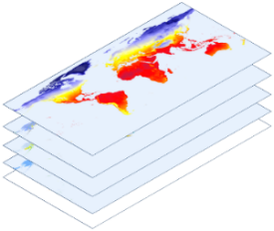

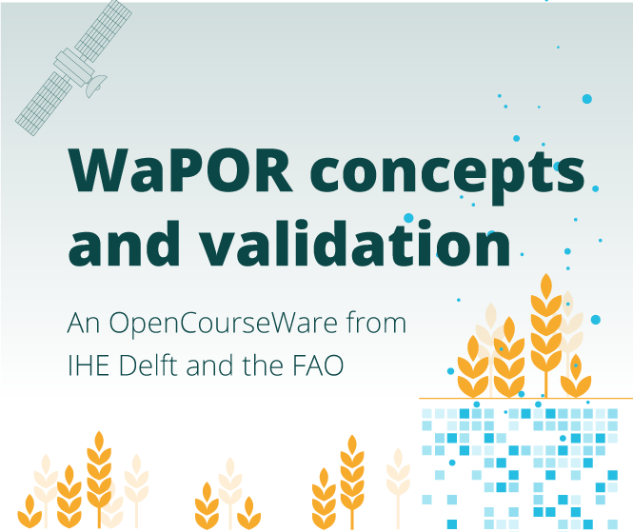



Knowledge sharing for sustainability
      Data distributed through ReST API for easier integration in ICT applications
      Open geospatial standards (wms, wcs, Cloud Optimized GeoTiff)
      Open codes and algorithms:
Wiki page for methodology
https://bitbucket.org/cioapps/wapor-et-look/wiki/Home
PyWaPOR https://www.fao.org/aquastat/py-wapor/index.html
      Online courses, tutorials, hackatons
      Catalog of WaPOR applications and uses

Slide 13

Action-oriented data for different users
Farmers and other end-users (app developers, agricultural entrepreneurs): advisory services
Irrigation scheme managers, WUAs, river basin authorities: monitoring water use and irrigation performance
scale
Policy makers: water allocation strategies, water productivity targets, SDGs

Slide 14

Join us to build a water and food secure future where no one is left behind
wapor.apps.fao.org
wapor@fao.org
www.fao.org/in-action/remote-sensing-for-water-productivity

